Slide 1
Temporal Resolution Study
Flow past a cylinder

Slide 2
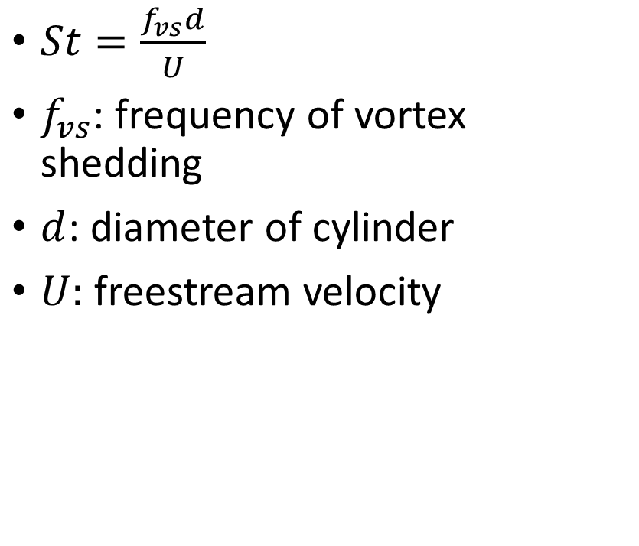
Background
$St=\frac{f_{vs}d}{U}$
$f_{vs}$: frequency of vortex shedding
$d$: diameter of cylinder
$U:$ freestream velocity
https://commons.wikimedia.org/wiki/File:Vortex-street-animation.gif

Slide 3

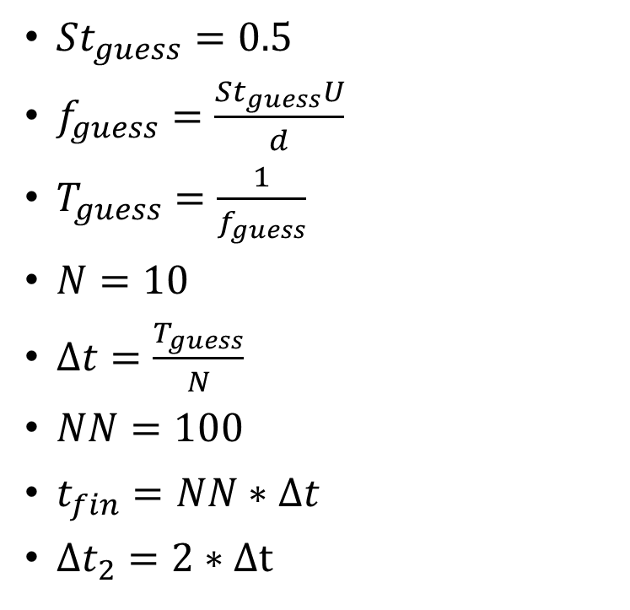


Equations
$St_{guess}=0.5$
$f_{guess}=\frac{St_{guess}U}{d}$
$T_{guess}=\frac{1}{f_{guess}}$
$N=10$
$Δt=\frac{T_{guess}}{N}$
$NN=100$
$t_{fin}=NN∗Δt$
$Δt_{2}=2∗Δt$
$t_{start}=\frac{W}{U}+0.25$
$$U$$
$$W$$

